Slide 1
Network Analysis

Slide 2
We are caught in an inescapable network of mutuality, tied in a single garment of destiny.
Whatever affects one directly, affects all indirectly.
-- Dr. Martin Luther King, Jr., 1963
Networks allow us to create relational maps of people, groups, topics, ideas.

Slide 3
Why Networks?
“If you’re studying something with networks, odds are you’re doing so because you think the objects of your study are interdependent rather than independent. Representing information as a network implicitly suggests not only that connections matter, but that they are required to understand whatever’s going on.”
Scott Weingart, Demystifying Networks

Slide 4
The “Stuff”
Network analysis generally deals with one or a small handful of types of stuff, and then a multitude of examples of that type.
Stuff = nodes (vertices/actors/agents/points)
Nodes can have attributes
Network analysis generally deals with one or a small handful of types of stuff, and then a multitude of examples of that type.
More nodes = multimodal

Slide 5
More About Nodes
Self-loop – sometimes nodes can connected to themselves in a network
(example: someone having a twitter thread)
Isolate – these are nodes that have no connection to any other node (example: someone who only RTs another’s tweet and no one replies to that tweet in a network displaying Twitter conversation where a certain hashtag is used)

Slide 6
Caveat working with Networks
”2-mode networks are difficult enough to work with, but once you get to three or more varieties of nodes, most algorithms used in network analysis simply do not work. It’s not that they can’t work; it’s just that most algorithms were only created to deal with networks with one variety of node.”
Scott Weingart, Demystifying Networks

Slide 7
The “Relationships”
Network analysis generally deals with one or a small handful of types of relationships, and then a multitude of examples of that type.
Relationships = edges (arcs/links/ties/relations)
A network can have many types of edges
Edges can also have attributes

Slide 8
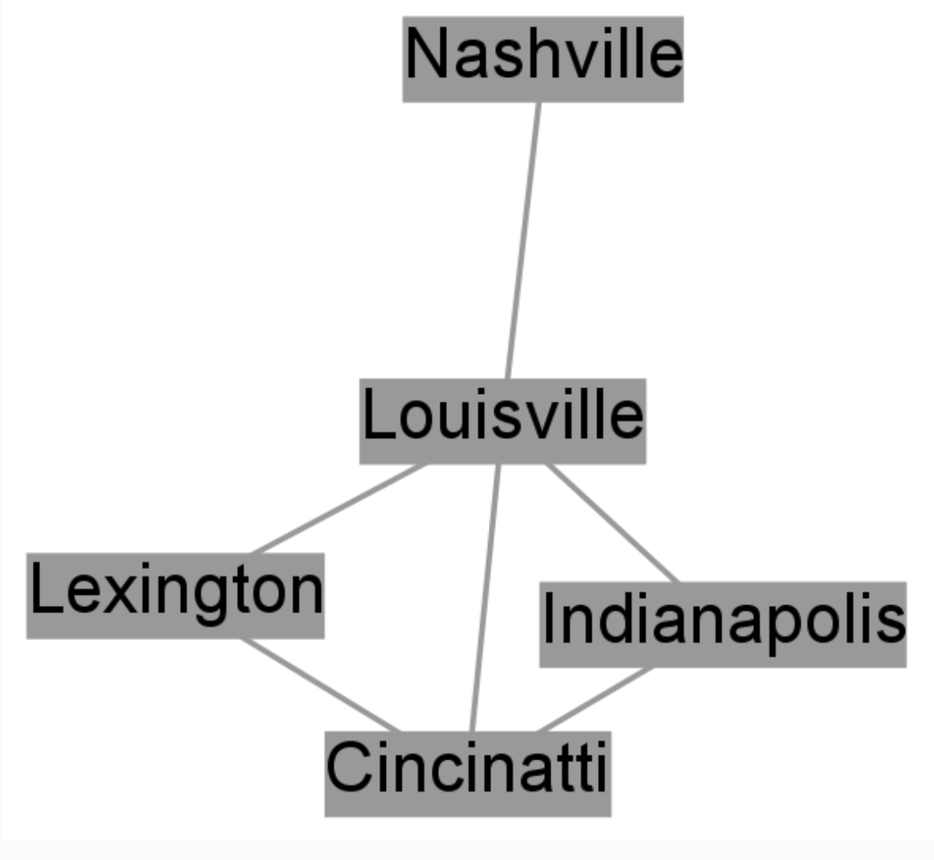
The Look of A Network
Edge
Node
graph from Scott Weingart, Demystifying Networks

Slide 9
Edge Attributes
Edges can be weighted – the more similar the more weighted
Can be explicit –an actual connection or inferred – interpreted connection (like similarity)
algorithms made to work on one may not work on the other; or perhaps they may, but their interpretative framework must change drastically

Slide 10
Types of Connection
symmetric - connection in both direction = undirected edge (often seen displayed as —)
Asymmetric – connection is one way = directed edge (often seen displayed as 🡪)
“That is, a person can be an author of a book, but a book cannot be an author of a book, nor can a person an author of a person. For a network to be truly bimodal, it must be of this form. Edges can go between types, but not among them…Combining both types is rarely a good idea. Some algorithms will still run when the two are combined, however the results usually make little sense.”
Scott Weingart, Demystifying Networks

Slide 11
Types of Networks
Dense – most nodes are connected
Sparse – most nodes are only connected to a small percentage of other nodes
Dense networks are not very interpretable so one has to decide where to cut off the network to remove density - for example, limiting the network to only nodes with high weighted edges

Slide 12
What can we do with Networks
Find:
Node’s Degree - how many edges a node has
Node Centrality - finds how central, or important, each node is in a network; consists of a node’s degree but can also reflect what node would change the look of the graph most if it was removed (how centrality is calculated is kind of a mystery)
Node degree works best as a measure of network centrality when you have full knowledge of the network, not when using an ego-network – a network with one person or object being analyzed. The thing being analyzed with always have the highest centrality this way). What one decides to include in the network will affected centrality.

Slide 13
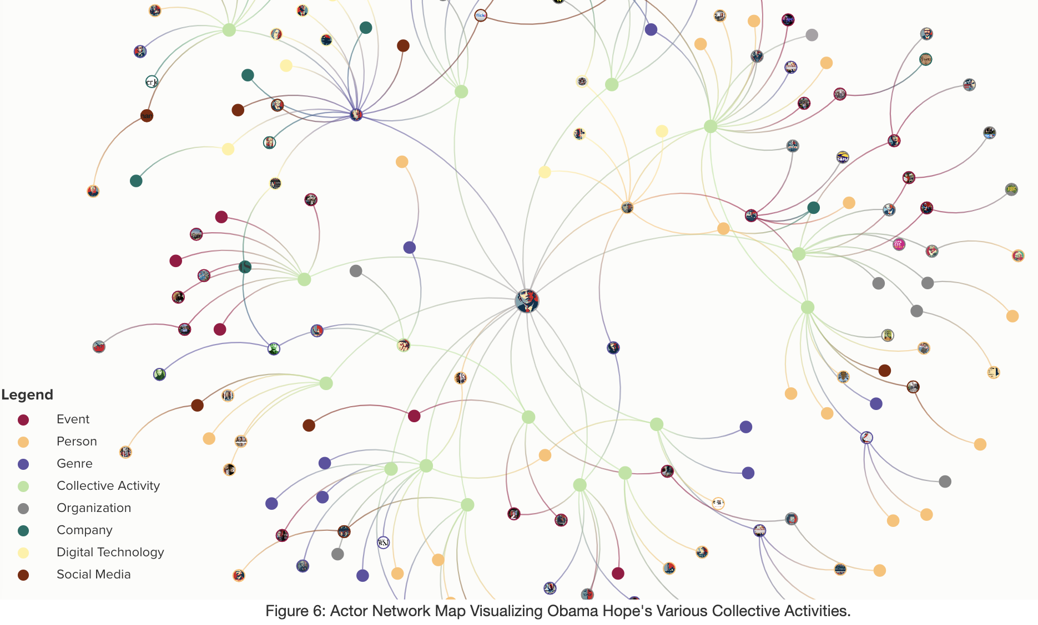
Can you identify the the parts of this network?
Graphic from Laurie Gries’ Mapping Obama Hope
Notes:
What kind of network is this? Can you identify the nodes, edges, and type of edges? What does the legend in this graphic represent?

Slide 14
Example Projects

Slide 15
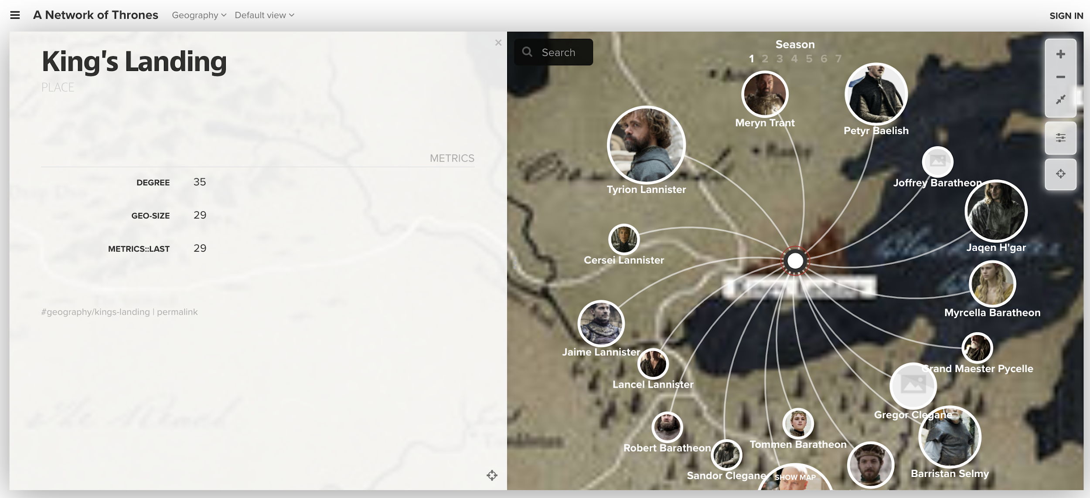
Game of Thrones
Notes:
Project used Kumu

Slide 16
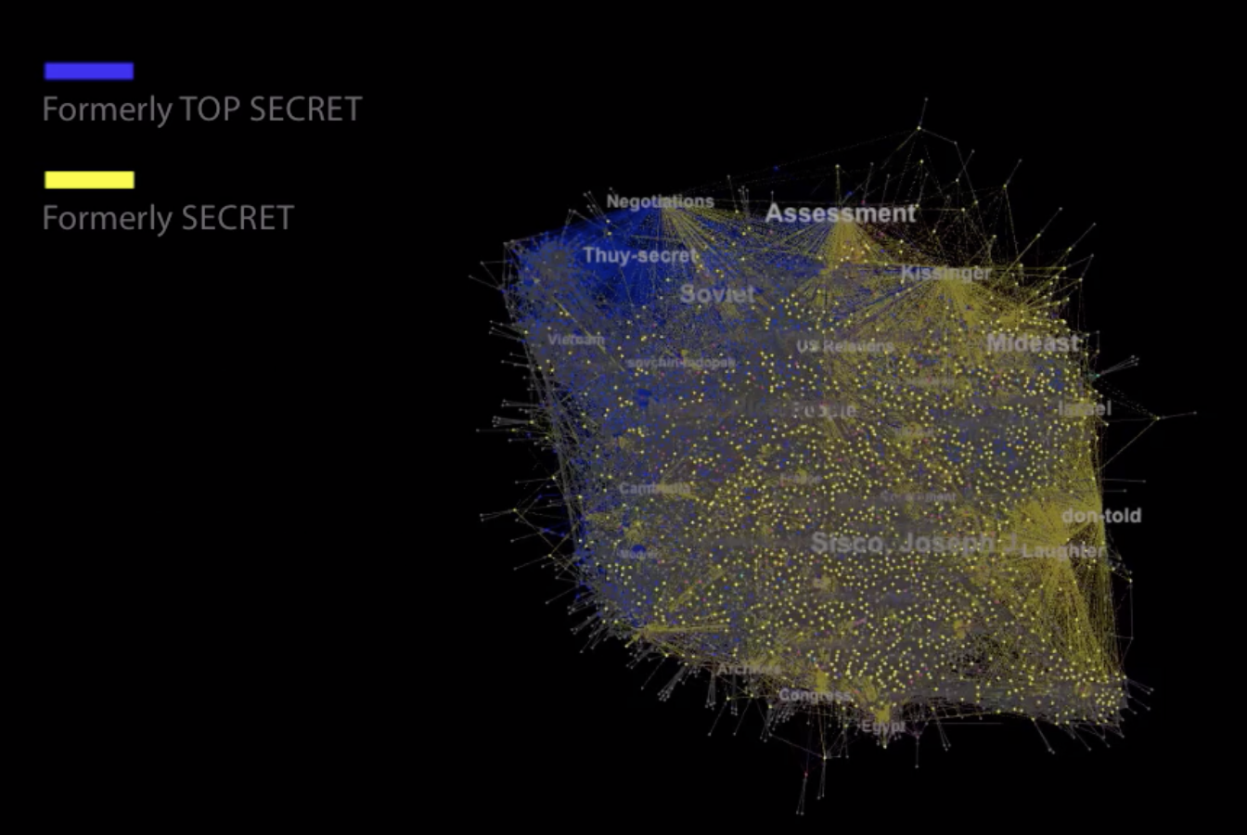
Qualifying Kissinger
Notes:
Project uses Gephi and Vimeo to create video for getting the graph online

Slide 17
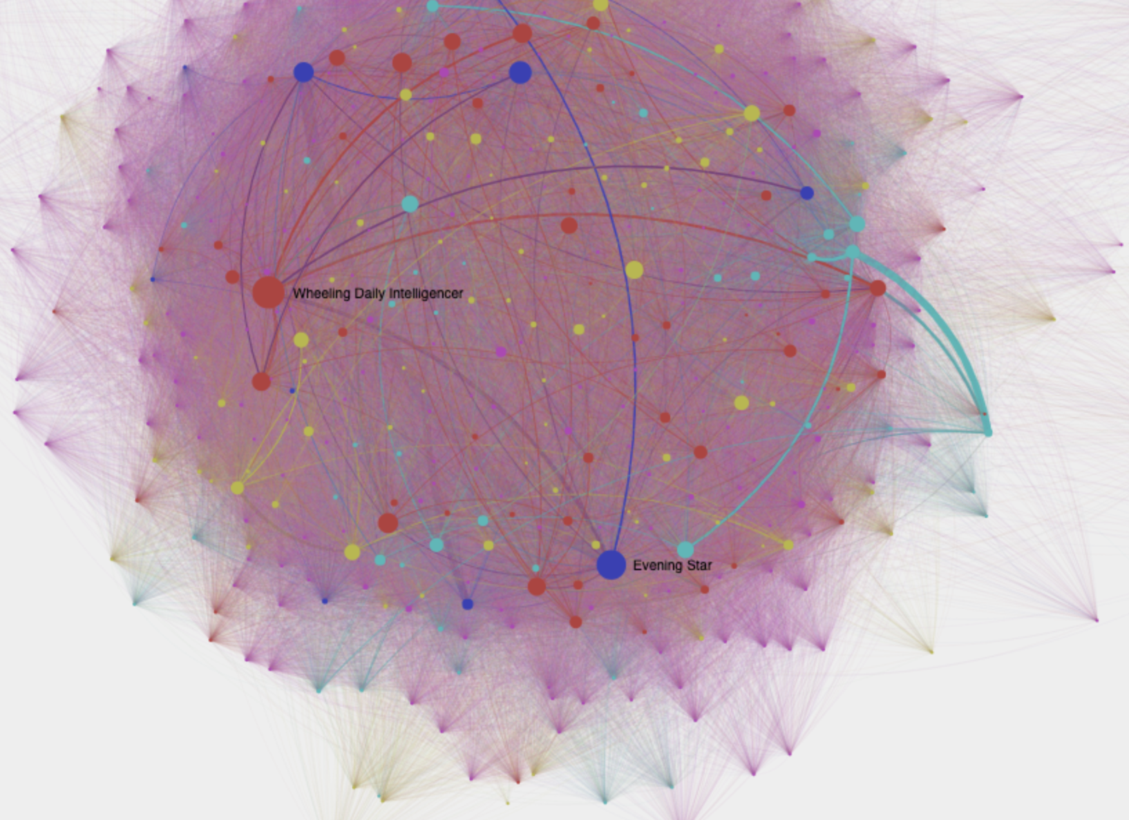
Viral Texts
Notes:
This project too uses Gephi, but has used the plugin to create a web-enabled network graphic

Slide 18
Tools for Network Analysis
Kumu – web-based network creation tool
No programming knowledge required
Freemium (free to a point) tool
NodeXL – extension for Microsoft Excel that allows one to create networks from data in Excel.
No programming knowledge required
Must license
Gephi and CytoScape – open source desktop tools to produce network graphs
These tools can do some advanced network calculation so better knowledge of networks to utilize fully
Must install plugins to put these graphs online

